Slide 1
White paper about AWS
By Pennyitsupport.eu
07/04/2019

Slide 2

About Amazon cloud
Well, to cut to the chase, Amazon cloud is this:
  Move your business to us, don’t worry, we take care of everything, go out, see a movie, have a good time, have fun
  We manage bilions of microservices worldwide
  You just do your business, make money, we take care of your [development] platform
But wait a minute: I already heard this in the ’70s or ‘80s. It was about the industrial food right?
Now hold on: 40 years later what left ? A massive move toward home-made stuff, right ?

Slide 3

About Amazon cloud (2)
Amazon cloud is the same. Amazon cloud for corporate IT is what industrial food was in the ’70s or ´80s, and you see what happened 40 years later
So don’t get rid too quickly of your ‘home-made’ IT infrastructure, cos rebuild it, mainly the competences, might take another 10 years or so
Loosing competences and knowledge on cloud infrastructure might cost you a lot and prevent building the best tailored infrastructure for

Slide 4
About Amazon cloud (3)
With AWS, if you do only AWS, the main issue is that
You loose competences and knowledge on cloud infrastructure and along with it you loose the ability to build yourself the best tailored infrastructure; if one day you want to have such an environment overnight, you will be forced to outsource, which is another headache
And, you need to revisit completely your security and IT security concept and get into the AWS Shared Responsibility model

Slide 5
About Amazon cloud (4)
Last but not least
You need to review and migrate your mockups of a complex Information Sytem infrastructure into the AWS VPC
You need to address the risks of connection failure to the VPC infrastructure resulting in work outage for your developers
To mention only few

Slide 6
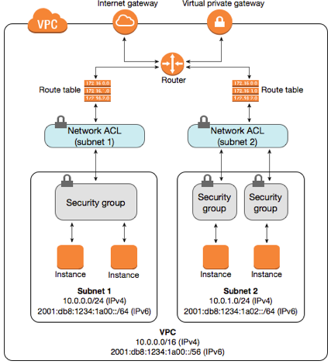


Have a look on the Amazon VPC generic architecture
  A generic deployment in Amazon VPC looks like this
Notes:
Amazon

Slide 7
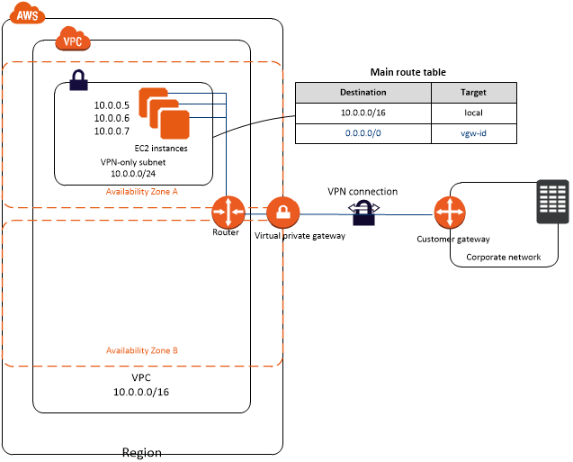

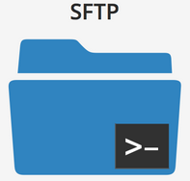
… and on the Amazon VPC in a Corporate network integration scenario
  VPC with a Private Subnet and AWS Site-to-Site VPN Access
Notes:
DIGIT cloud services

Slide 8
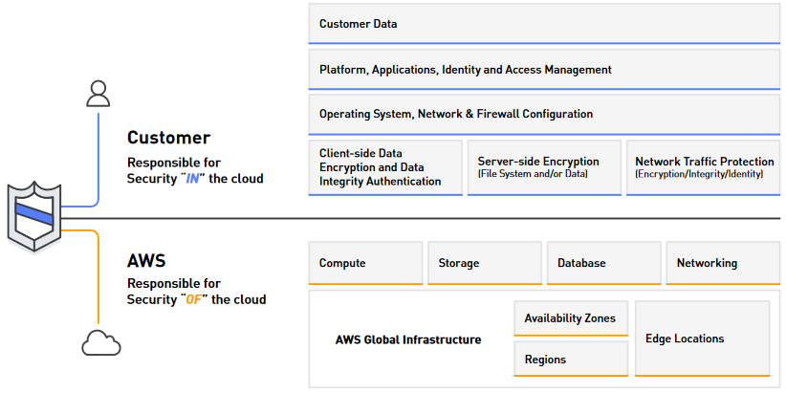
2. Main security concerns in AWS
  AWS Shared Responsibility Model recall

Slide 9
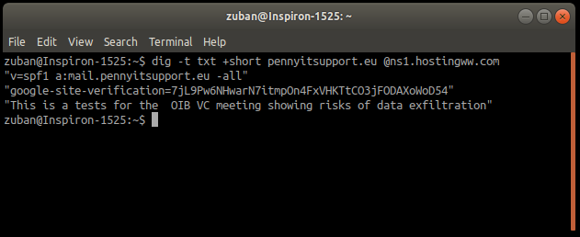


Main security concerns in AWS (2)
  AWS DNS
  Service transparently allowed even if not selected at the VPC creation
  Uses UDP
  AWS uses DNS service for Amazon RDS
  The DNS has 3 attributes: Authoritative, Cache, Recursive
  Text based
  Can be exploited for data exfiltration
  HTTPS protocol: Although the evaluation of the protocol suite gives an grade to the AWS console (there are sites featuring A++ grade) HTTPS risks are there
  No Evaluation/Monitoring of the Open source software
  Exposed to
  Host base intrusion
  Network based intrusion
  Risk of credential theft ( ? Multi Factor Authentication seems active )
  No logins monitor ?
  Not secure from malware inclusion in the developed software

Slide 10
AWS development environment limitations
  Availability of the whole IS landscape to integrate a complex development in a test environment, beyond just unit testing
  Availability of Mockups
  Development move to and from corporate environment through specific technologies and manipulation is subject of errors and mis-manipulation
  Availability of acceptance environment integrated with the development that real users could test, unless developing specific APIs for that
  Risk of commercial war (Amazon vs Oracle) https://youtu.be/xrzMYL901AQ
  € of the service

Slide 11
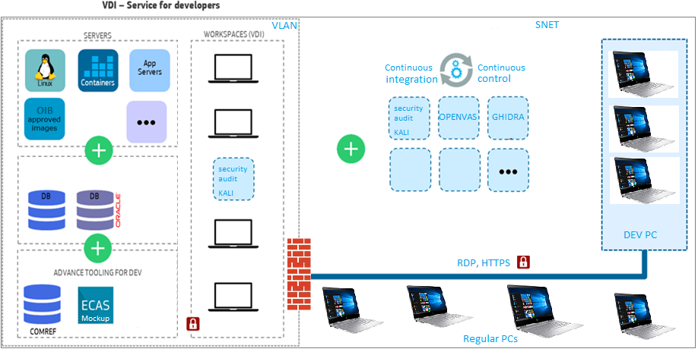
About Amazon cloud in a hybrid environment (private part)
Notes:
DIGIT cloud services

Slide 12
Amazon cloud in a hybrid environment (private part)
  I find hybrid environment the one enjoying benefits of both worlds
  Private environment part completely secure in a VLAN based on native firewall, in corporate network not script based proxy
  Compliant with most if not all corporate IT governances
  No (additional ) data exfiltration risk
  HTTPS and RDP protocol inside corporate network
  Integrated Monitoring of the Open source software with KALI and other industry standard tools
  Limited exposure to
  Host base intrusion
  Network based intrusion
  Risk of credential theft

Slide 13
Amazon cloud in a hybrid environment
So
For corporate customers I think the Hybrid cloud strategy is the best.
Now, let’s be honest, Amazon cloud is an amazing tool:
  Extreme flexilbility building your own environment
  Scalability
  Pay as you go
But limitations are there, as explained before and in a summary next

Slide 14
In a hybrid environment
Corporate customers would use corporate cloud for long term iterative applications allowing:
  Cost efficiency up to €/10 of the service on long term
  Maintain of skills,
  Higher security
  Integration with the corporate IT infrastructure in the development process (Test, Acceptance, Mockups, application servers, container technologies (main Docker by request)

Slide 15
In a hybrid environment (2)
But would use AWS for short projects, requiring
  quick setup, mainly, the kind of one shot action limited in time, where agility is key
  Scalability
  Pay as you for the quick setup AWS service

